Slide 1
SPORTY SHOE PROJECT
Sporty shoe is an ecommerce web application where user can buy products related to footwears.

Slide 2
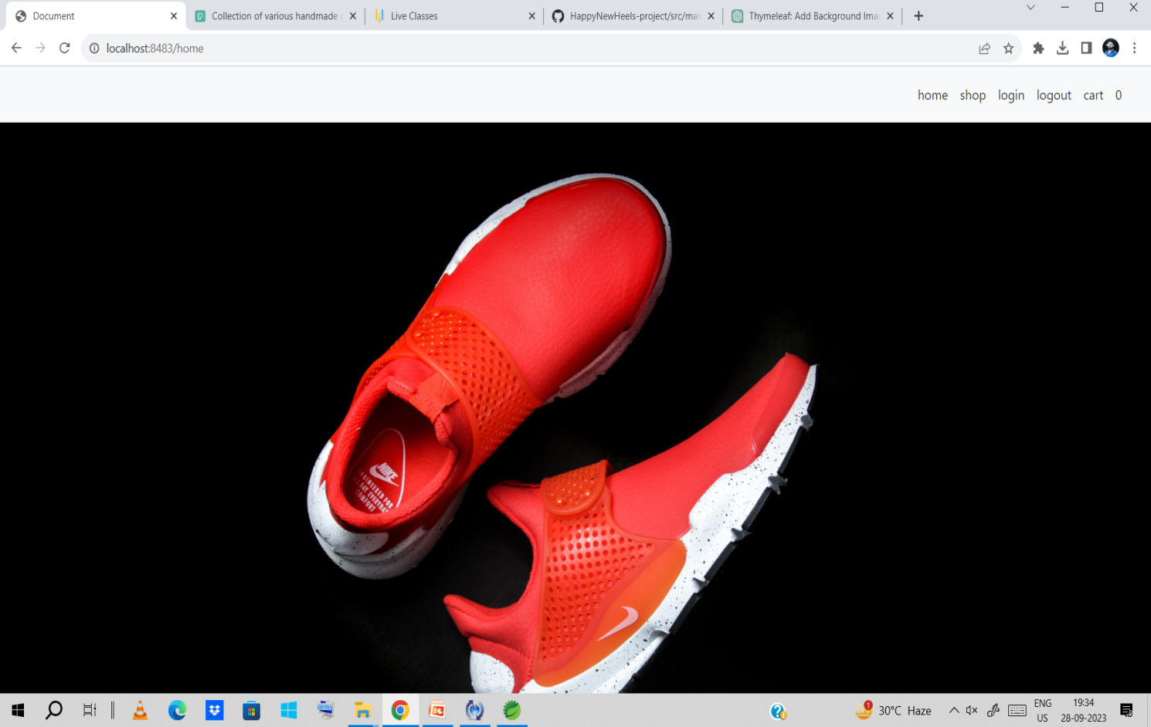
When user open this website an homepage will open. Suppose user selects shop option from the navigation bar, then user will redirected to the shop API where user can see all the products.

Slide 3
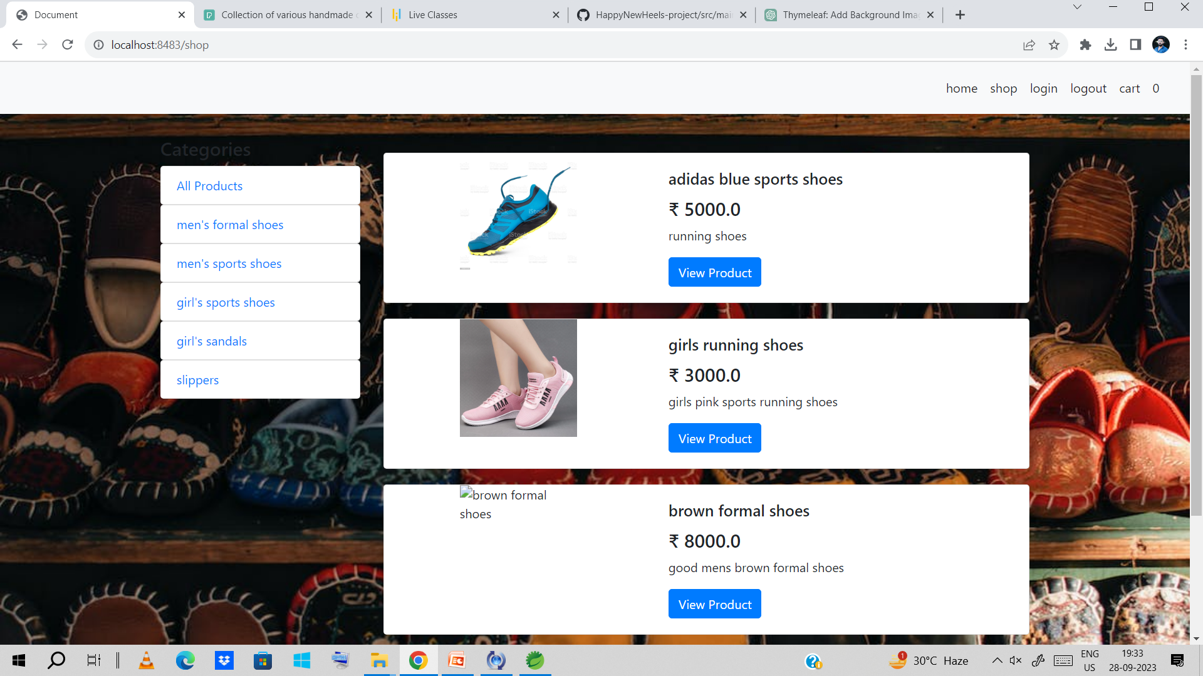
Here user will be able to see all the products. User can also filter the products by selection the categories option and by clicking on the View Product Button user can view the product details, price and availability of the product. Suppose now user will select men’s sports shoes to view only men’s shoe products.

Slide 4
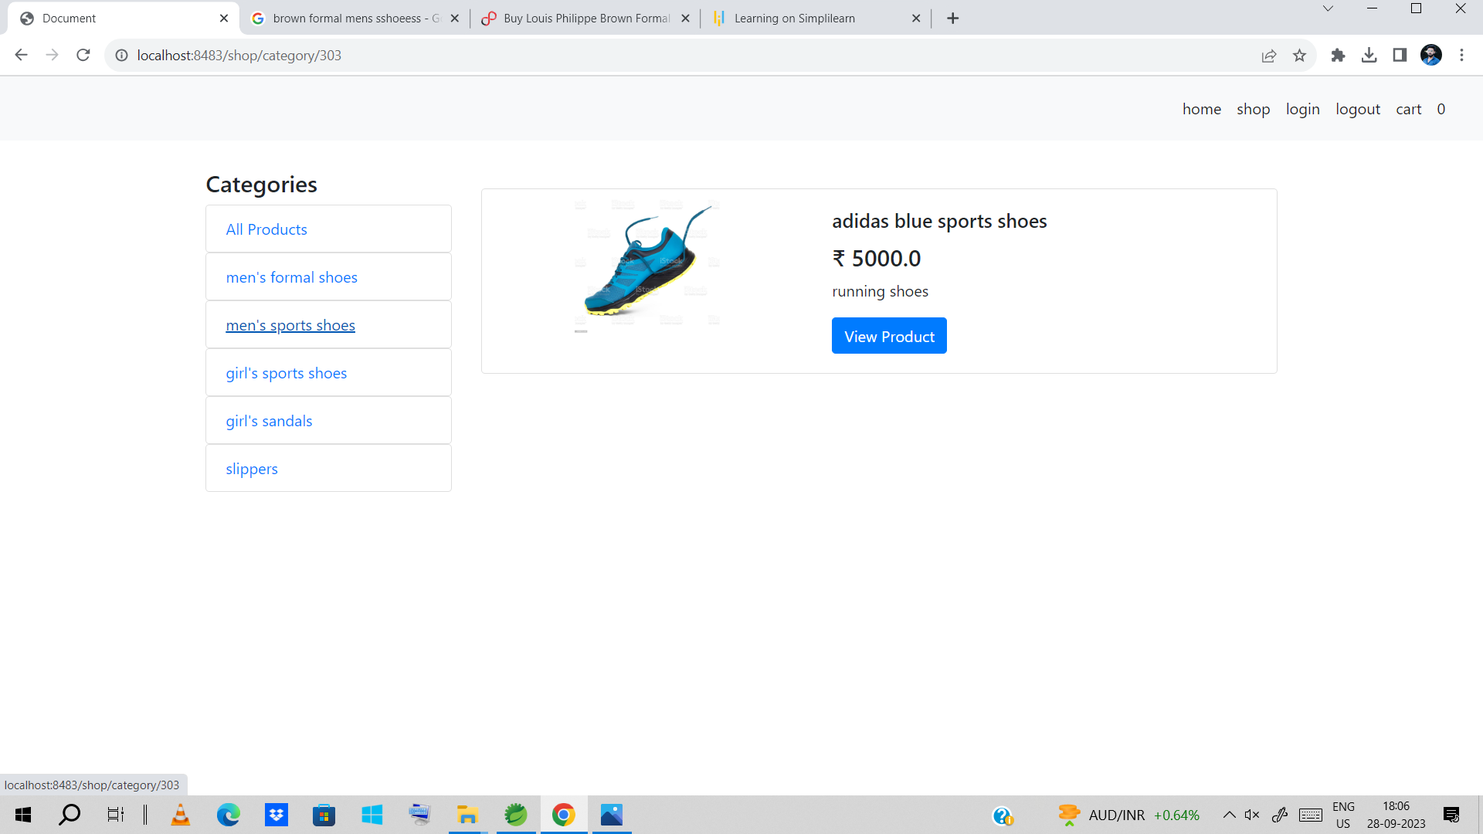
Here only men’s sports shoes categories product will be seen. User can view product by clicking on the View Product Button.

Slide 5
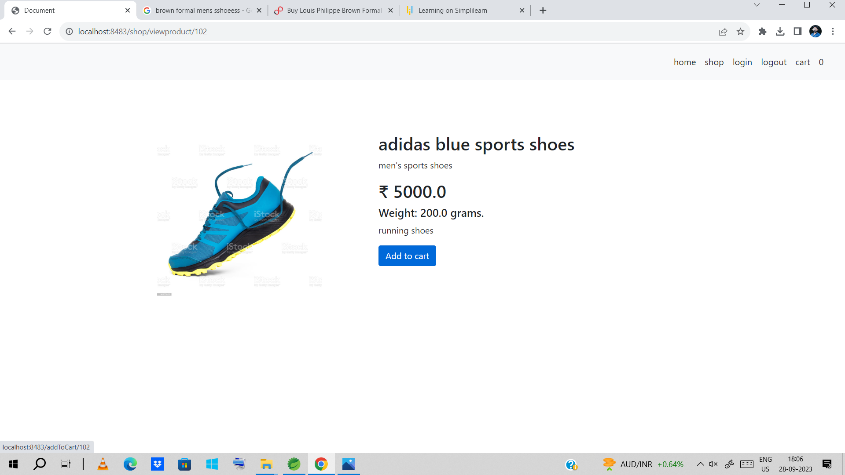
If the user want to add the product to the cart, user can add the product to the cart by clicking the Add to cart button. After clicking add to cart button the user will be redirected to the shop API by incresing the cart count from 0 to 1 in the top right corner.

Slide 6
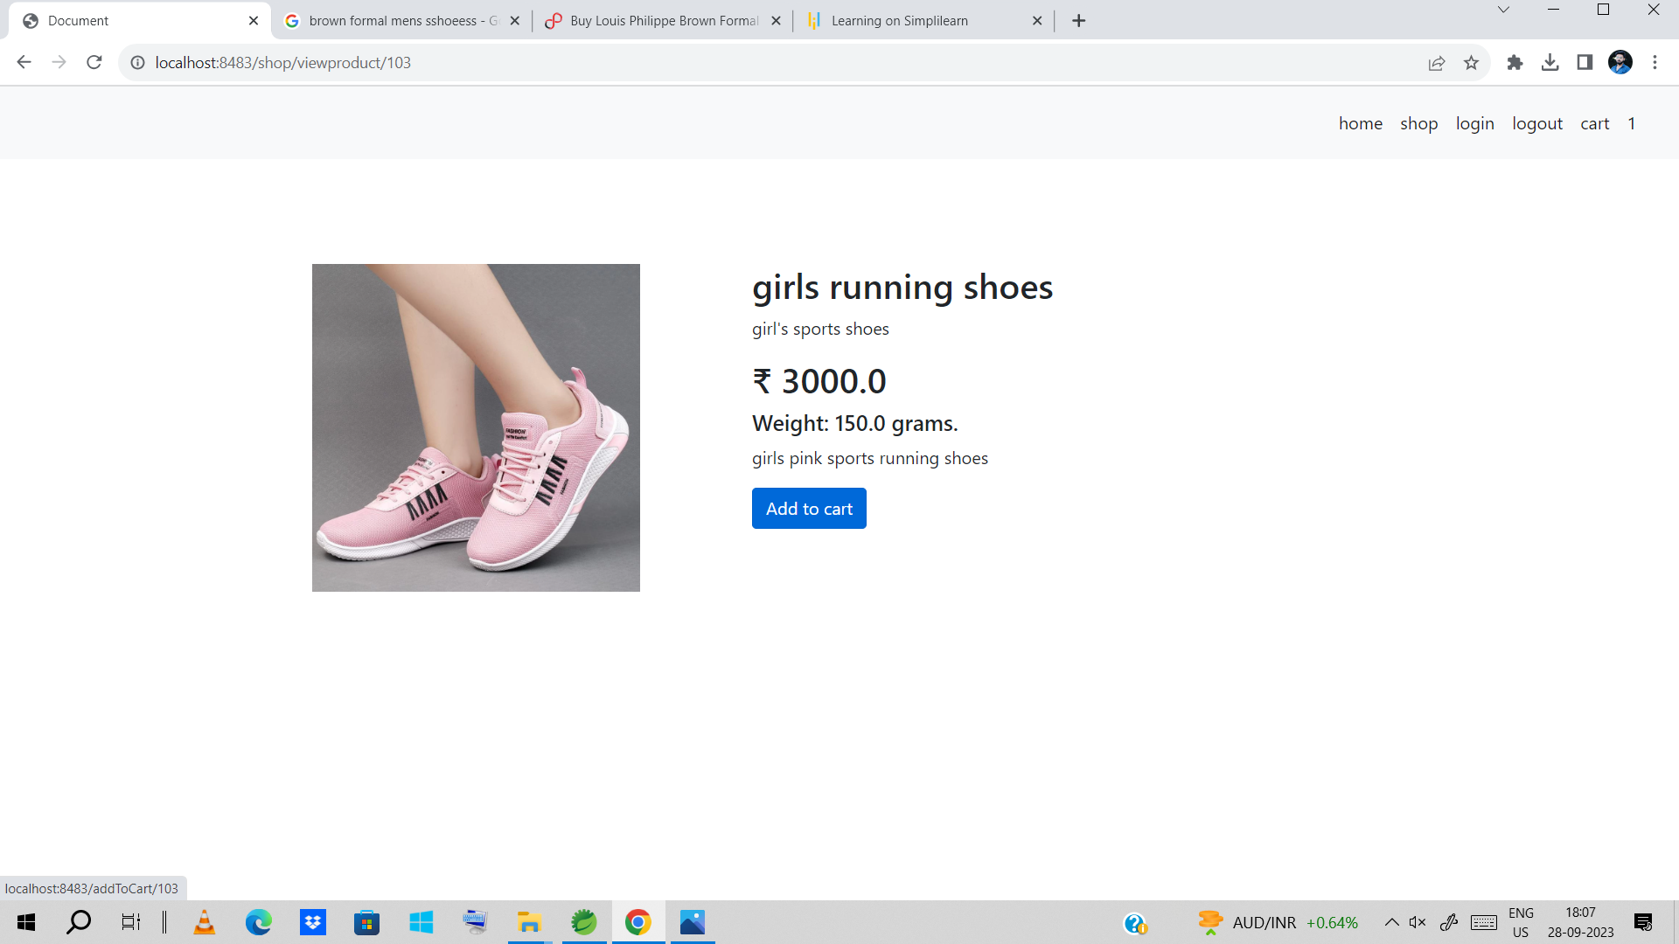
Cart value has been increased from 0 to 1 as compared to previous slide in the top right corner. Suppose user will add one more product to the cart. Then the cart value is changed from 1 to 2 in the top right corner of navigation bar and then it will redirect to shop API in the next slide u willl able to see.

Slide 7
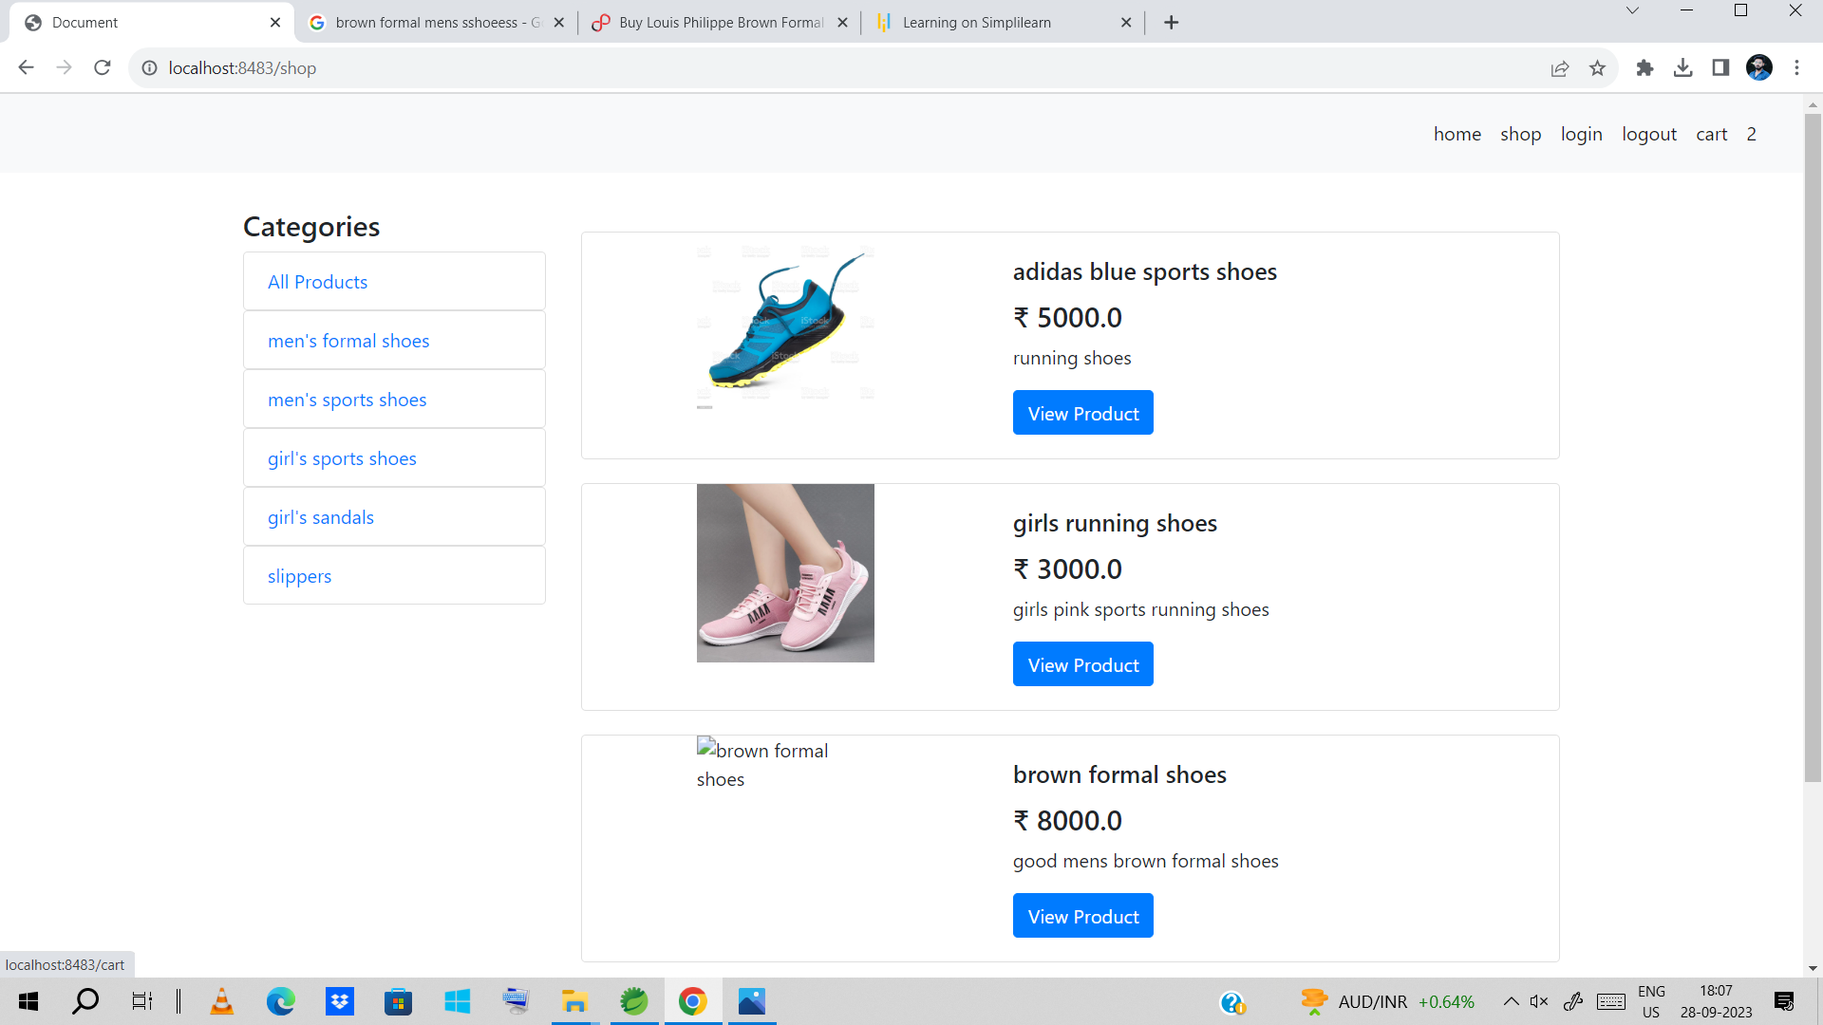
You can clearly see the that cart value is changed from 1 to 2 in the top right corner of the navigation bar as compared to previous slide. And it is redirected to shop API.

Slide 8
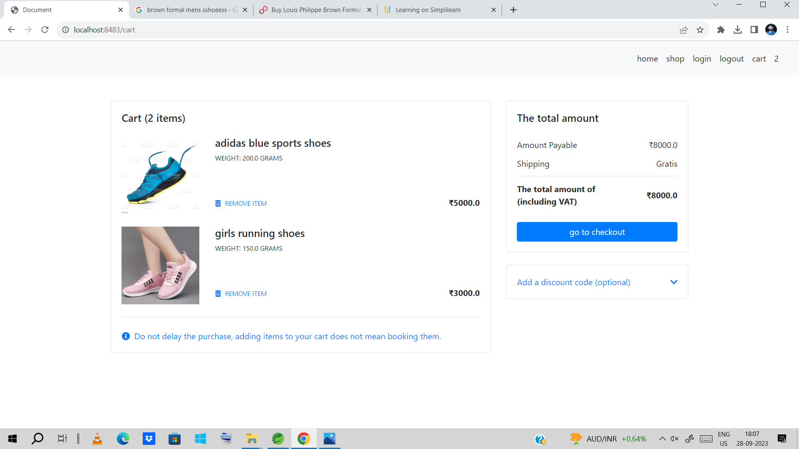
User can also check the item in the cart by clicking on the cart option present in the navigation bar. Now user will be able to see total price of the cart, user can also remove the product item from the cart by clicking on the remove item button. Suppose user wants to remove the remove the item from the cart by clicking on the remove item button.

Slide 9
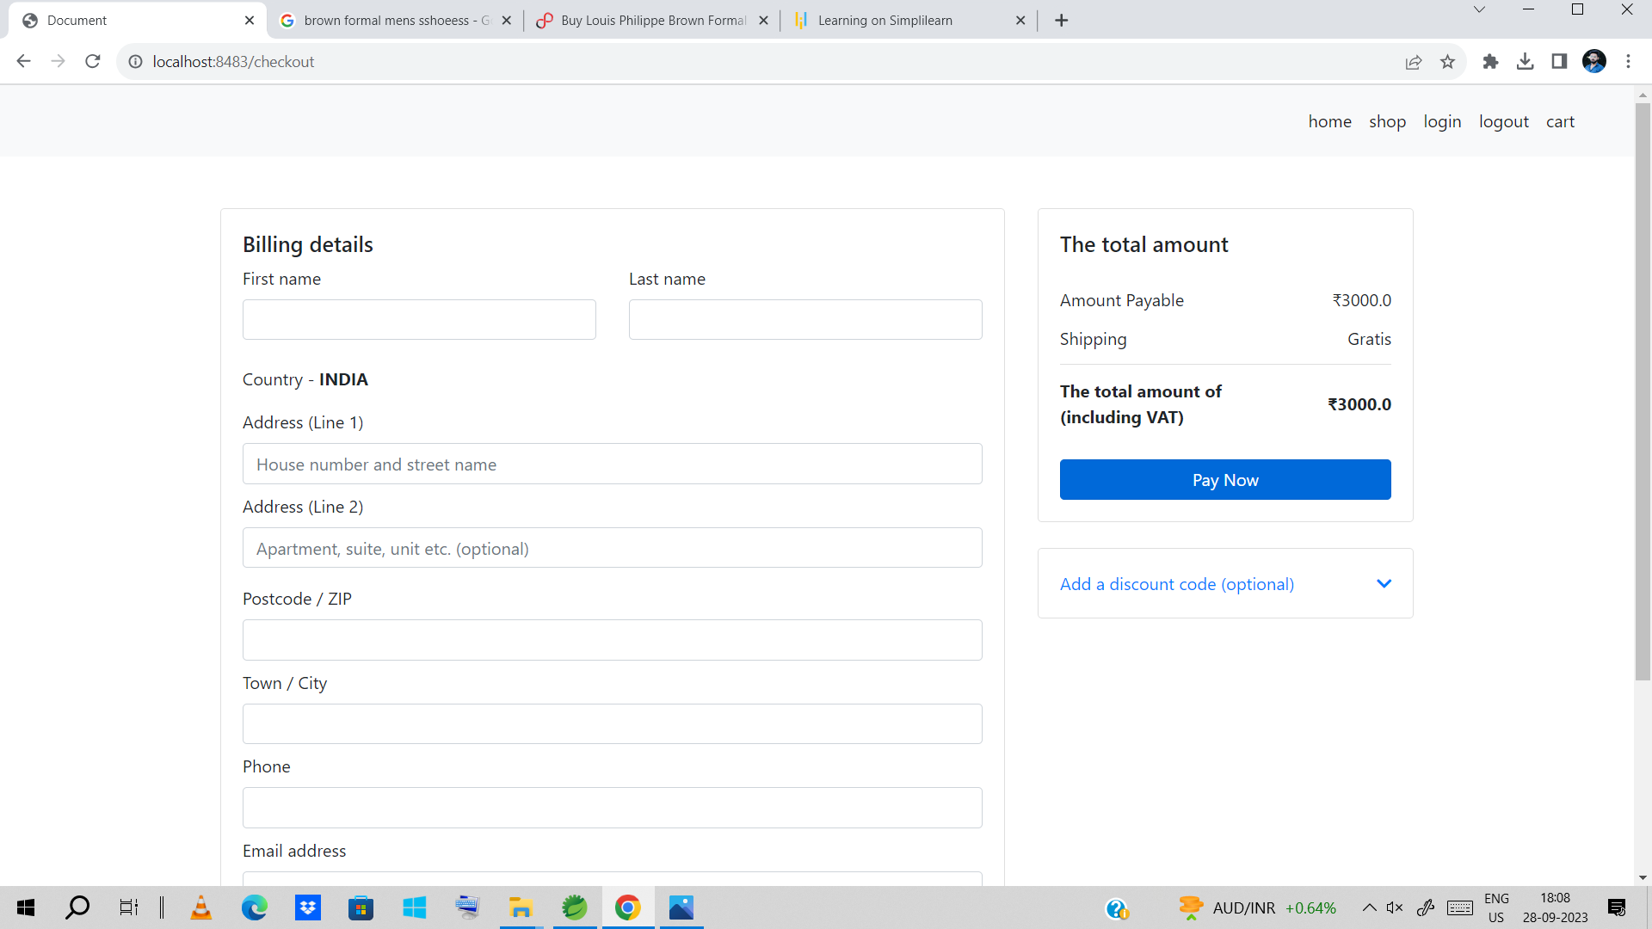
Here user will enter all the details in the form where user want to shipped the product. After successfully entering the details user can click on Pay Now Button from where user will be redirected to payment gateway API for successfully ordering the product for delivery.

Slide 10
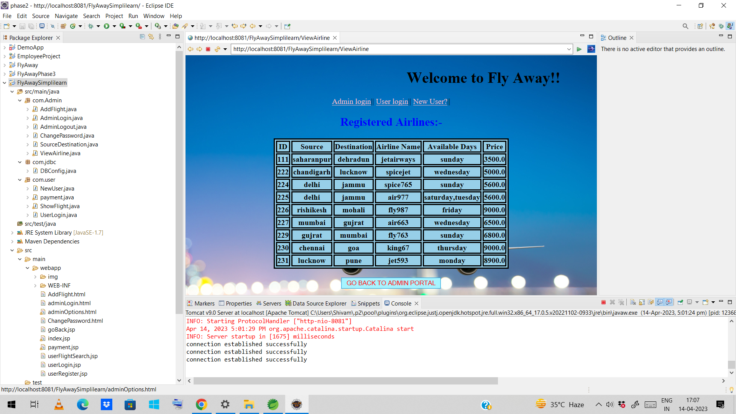
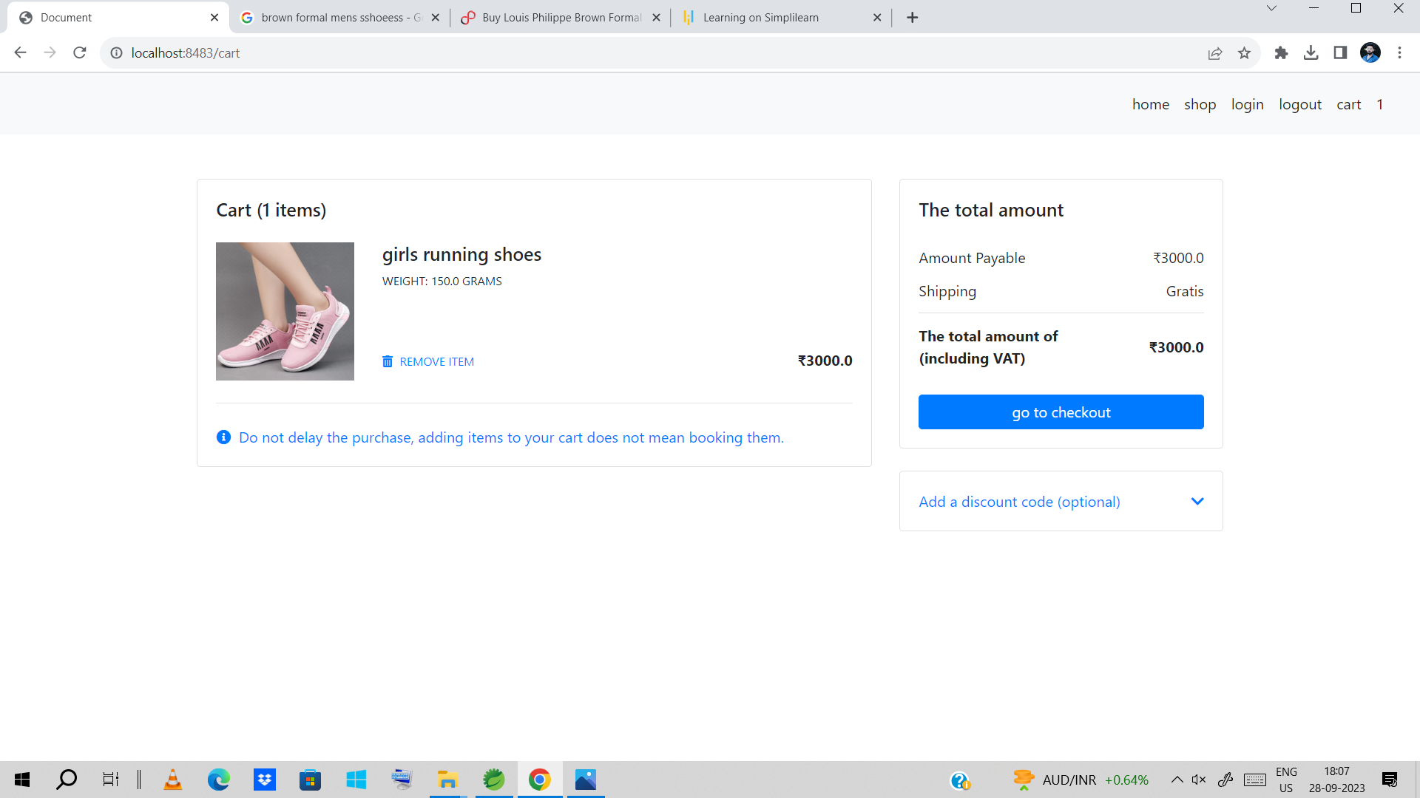
Item is removed successfully from the cart as compared to previous slide. Now user can go to checkout option where user get redirected to shipping address by entering all the details of the address where user want to delivered the product.

Slide 11
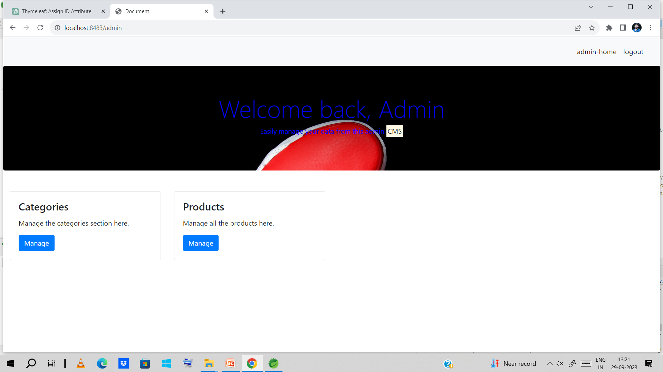
If user login as admin, then admin is able to add the categories of the product. Admin can update, delete and add the product and categories to store the data permanently in database. Suppose admin want to add the category by clicking on the manage categories button.

Slide 12
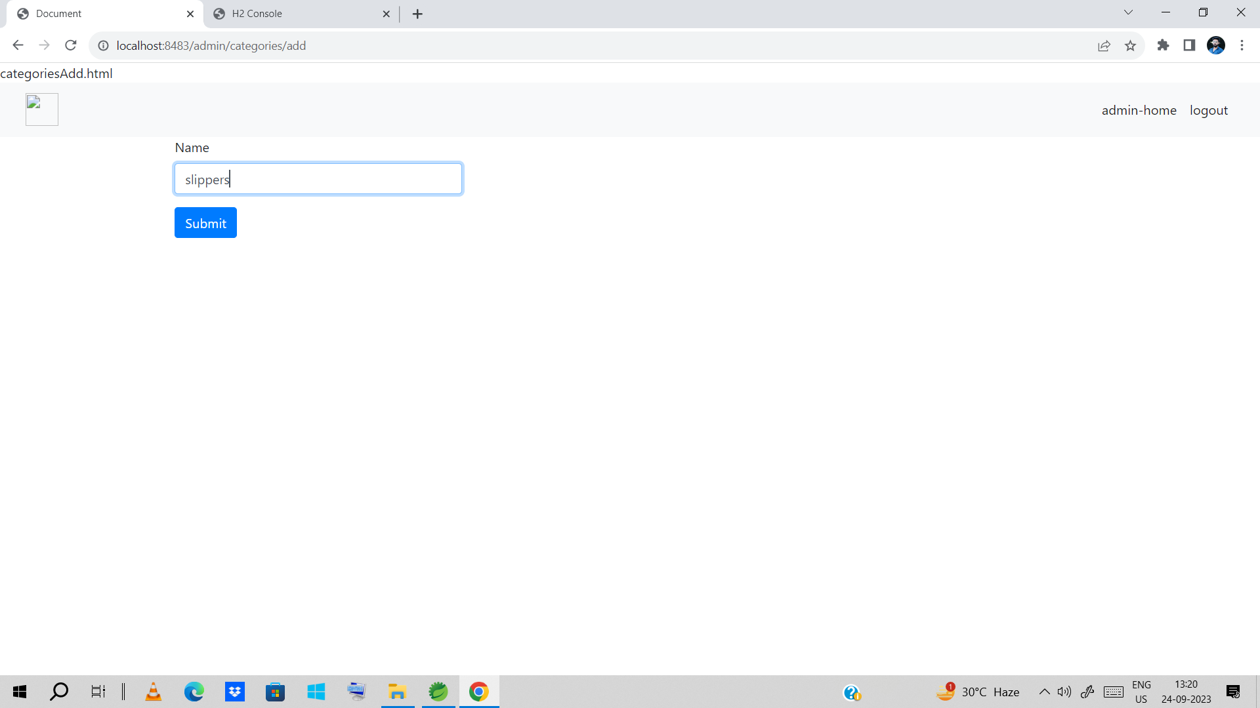
Here admin can enter the categories name and click on the submit button for successfully storing the categories in the database.

Slide 13
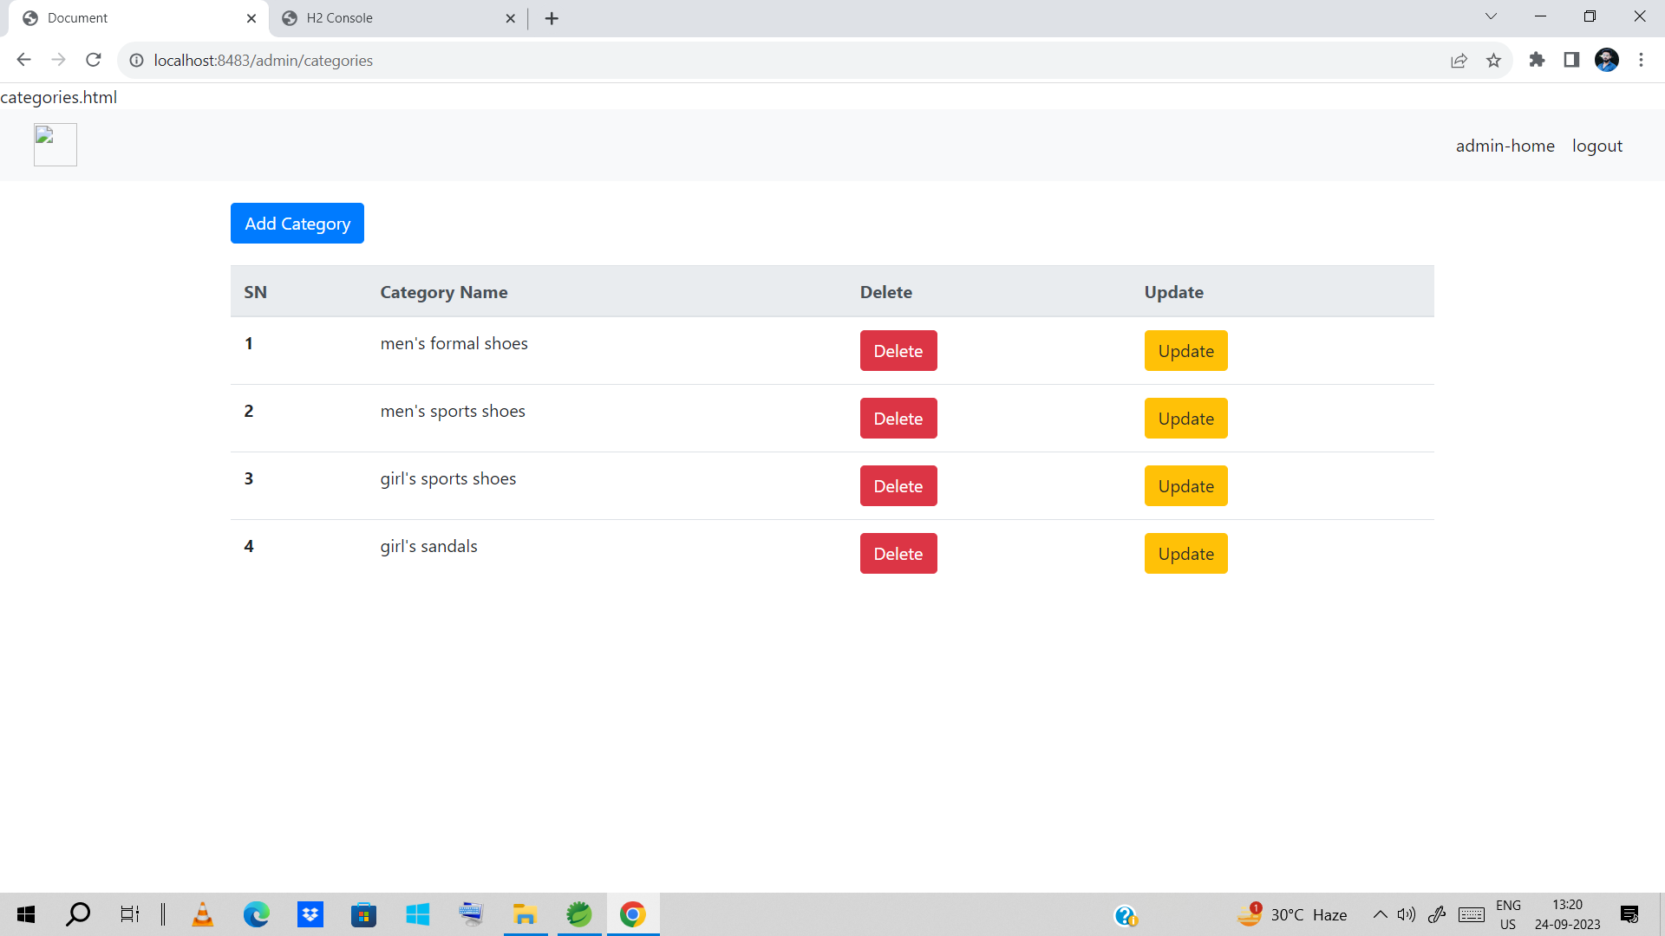
After submitting the categories successfully, admin is redirected to categories API where admin will able to see the categories list. Admin can update the categories and delete the categories as well accordingly.

Slide 14
Admin can also manage all the products by clicking on the button manage in products. Then admin will redirected to list of products API where admin will able to manage all the products accordingly.

Slide 15
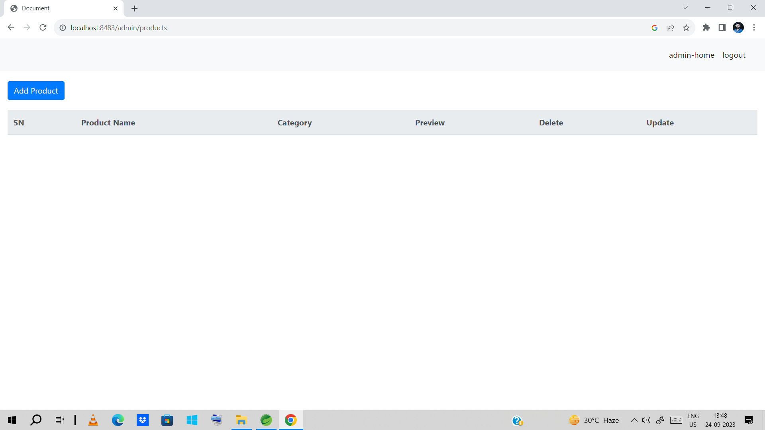
As u can see the list of products is empty now. So admin can add the products by clicking on the Add Product Button

Slide 16
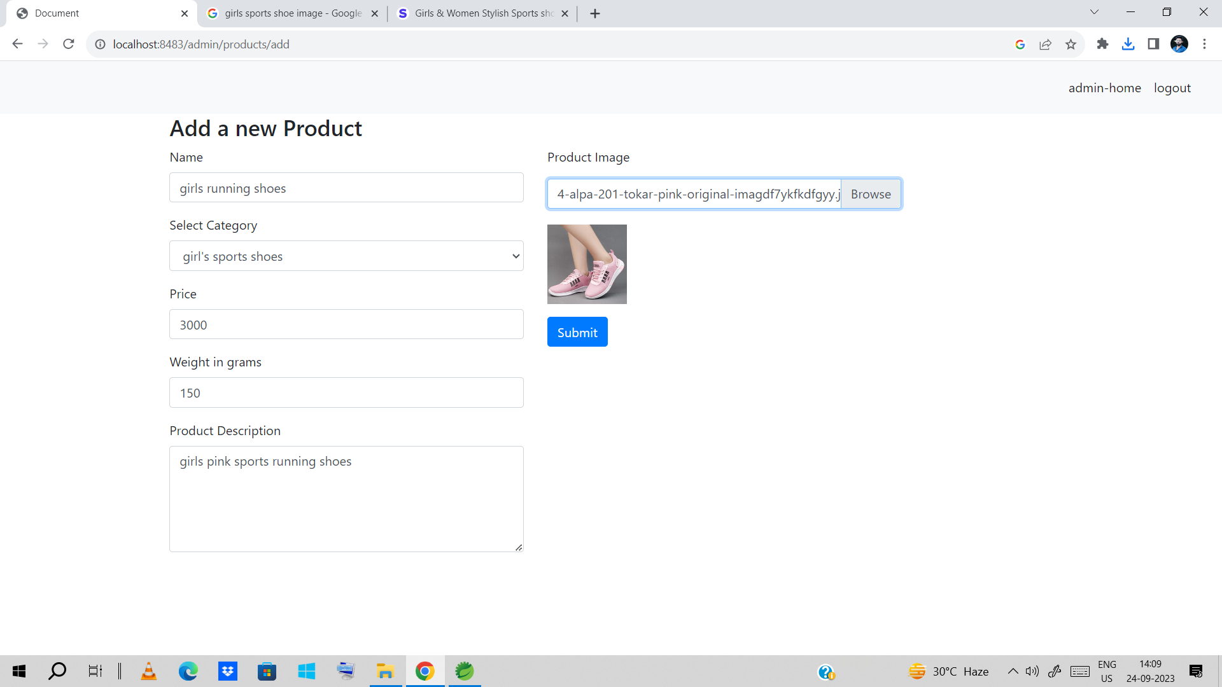
Here admin will enter the products details such as name, categories, price, weight, description and product image. Then submit products details by clicking on the submit button. Then admin will redirected to list of products API after submitting the product details.

Slide 17
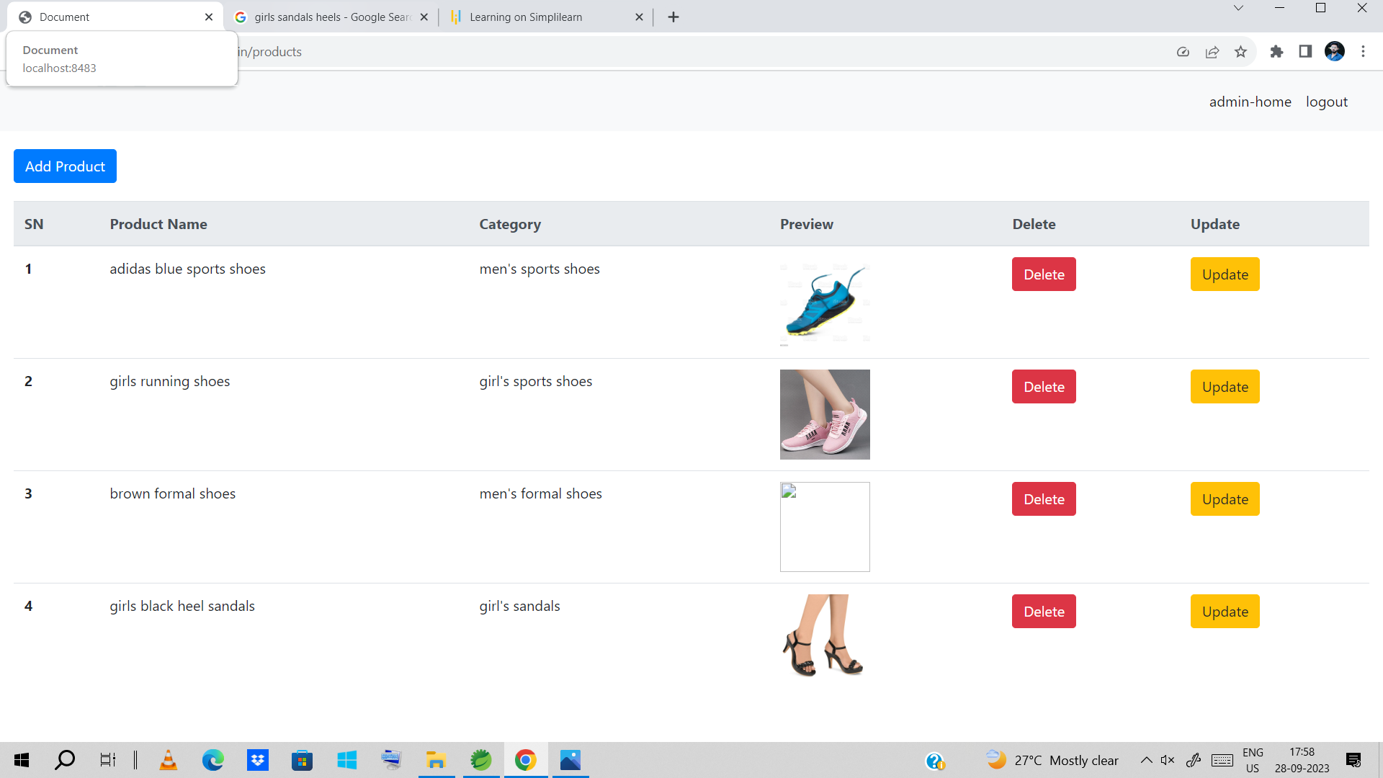
Here you will find the list of products submitted by the admin. Now Admin can update and delete the product from the list of products accordingly.

